Slide 1
Dirk Jacobs,
Director General FoodDrinkEurope
Trends in the European food industry and the state of global markets

Slide 2
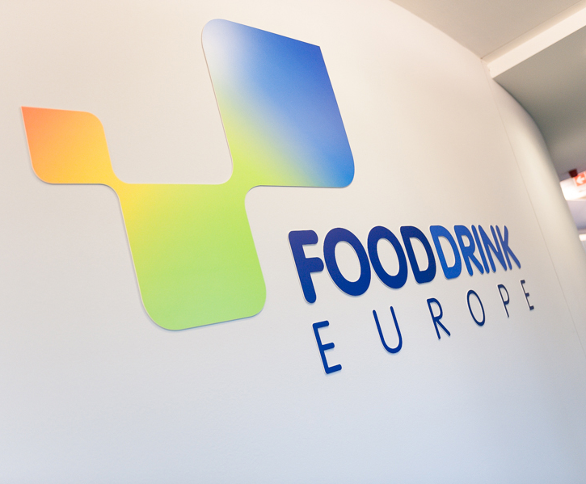

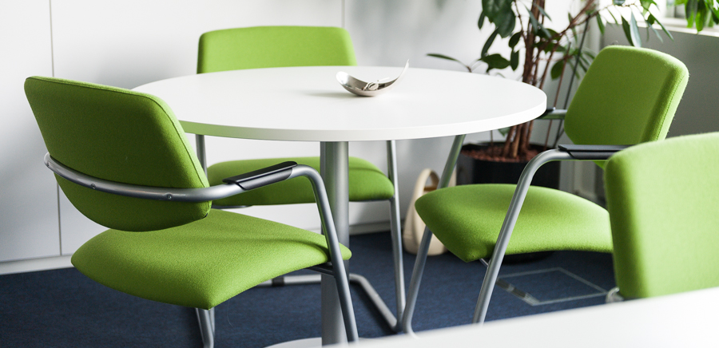
FoodDrinkEurope
Organisation of the European food and drink manufacturing industry
Founded in 1982
Based in Brussels, Belgium
Reference point for EU and international institutions

Slide 3
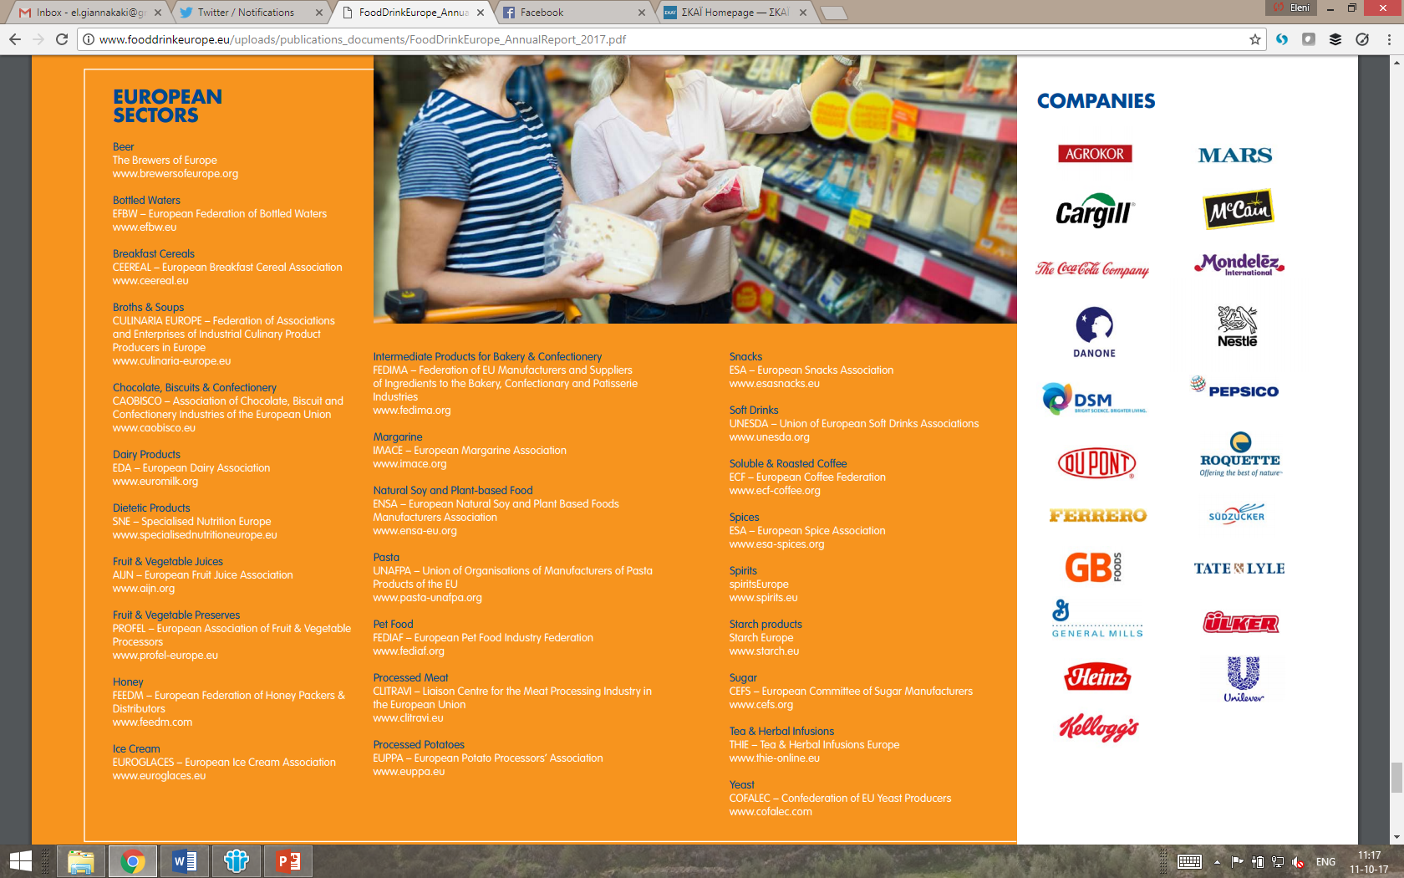

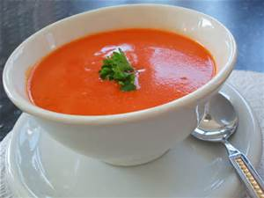
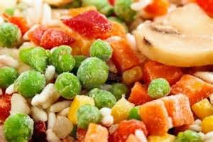


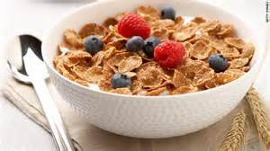
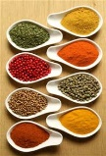
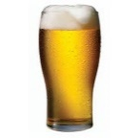
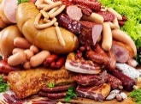
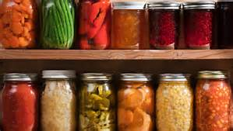
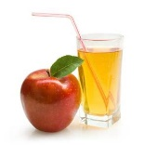
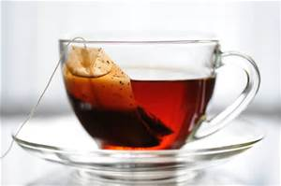
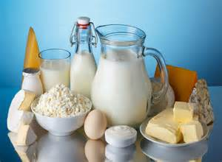
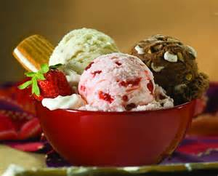


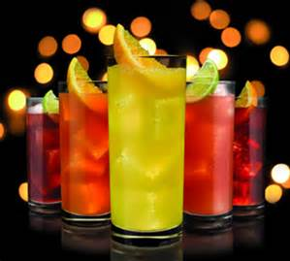
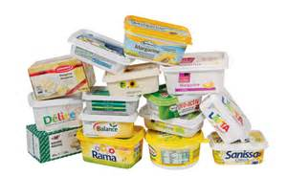
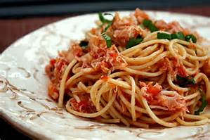
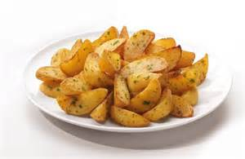


Members
25 National Federations
26 EU Sector Associations
23 Liaison Companies

Slide 4
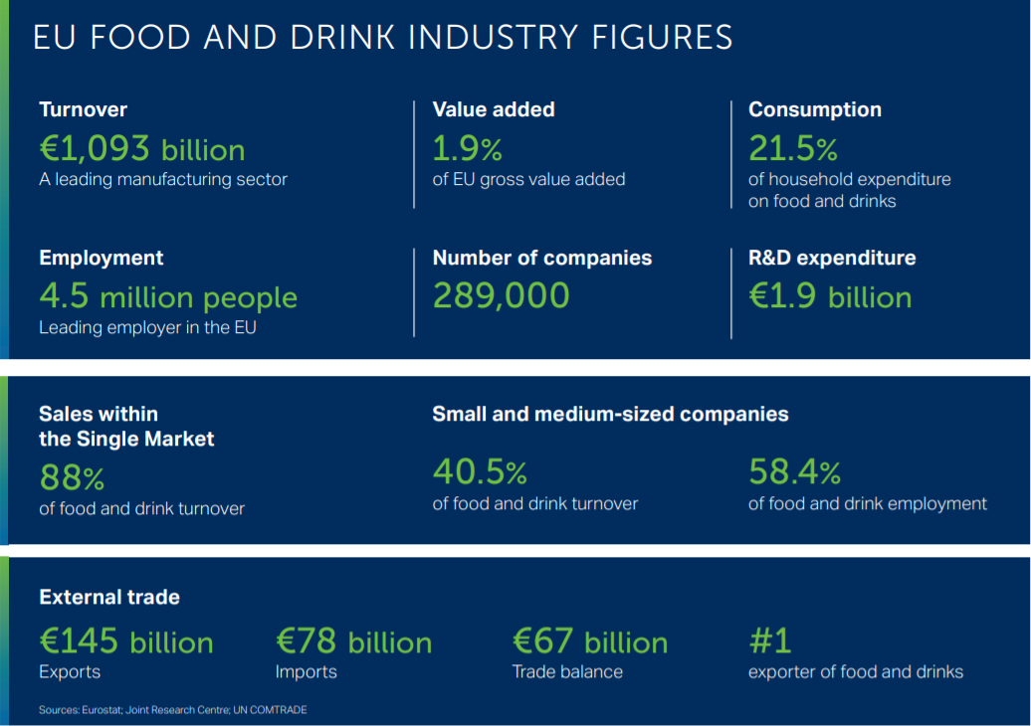
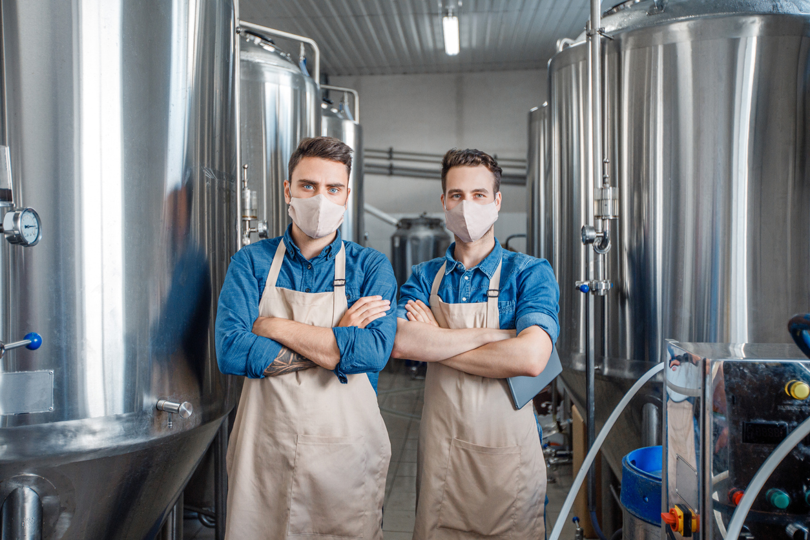
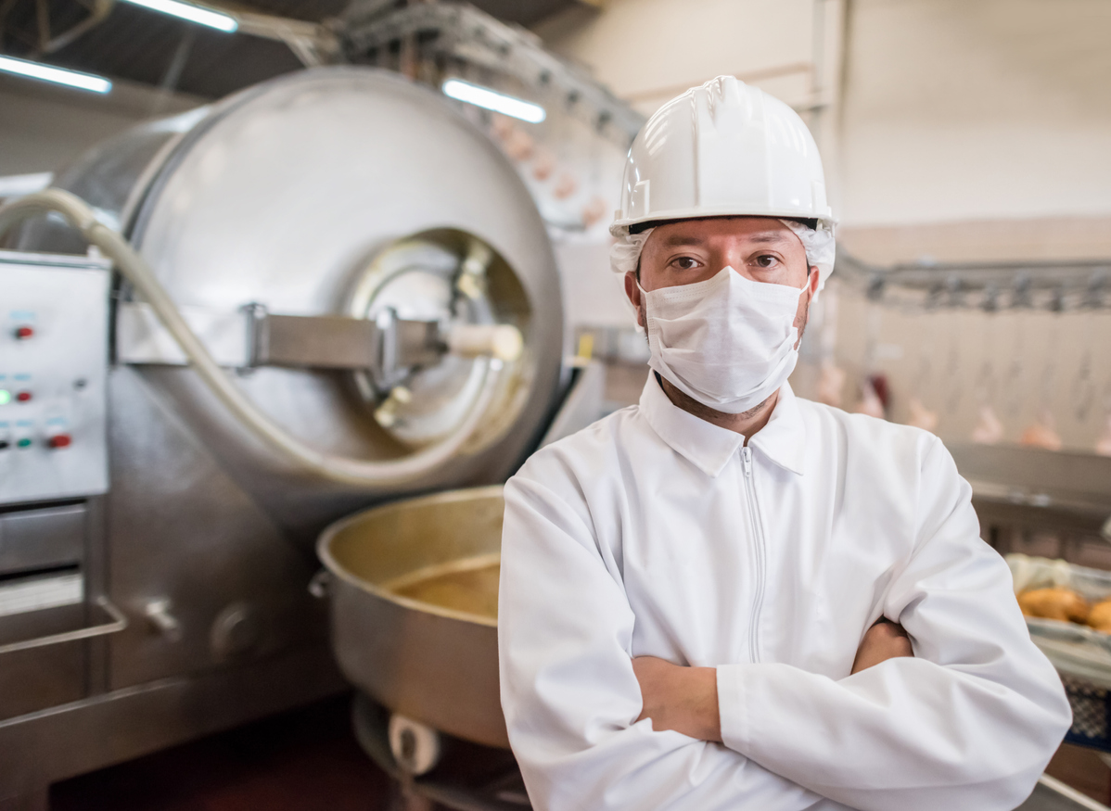
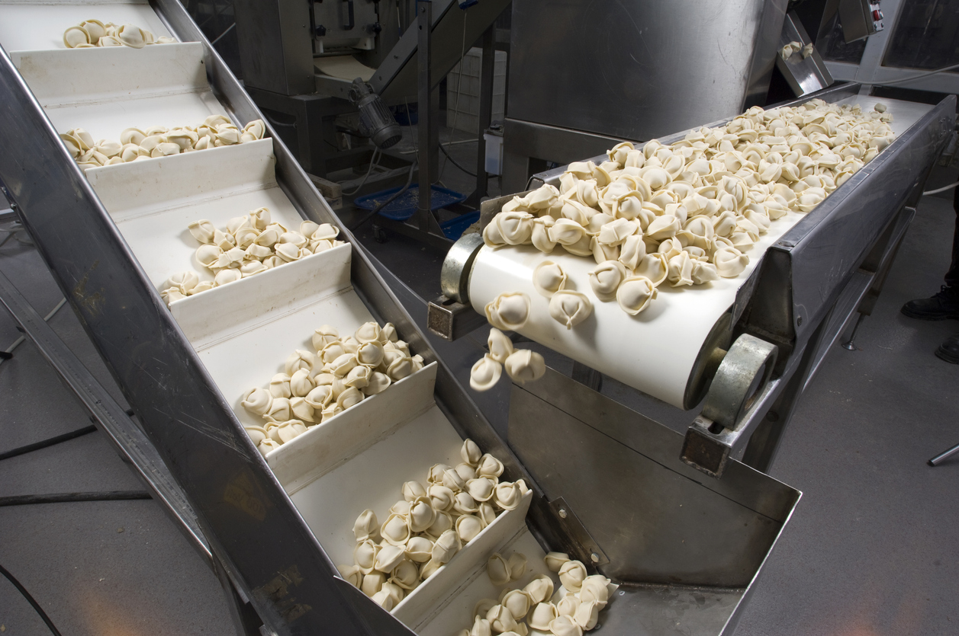
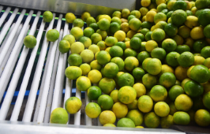

Slide 5

A ‘perfect’ storm of cascading crises
Public health pandemic
War and geopolitical tensions
Cost inflation
Climate change
Global food (and energy) insecurity → risk of increased hunger & social unrest

Slide 6
Impact on European food and drink sector
Inputs
Agricultural raw materials
Energy
Packaging
Markets
Distribution/sales channels
Export restrictions
Logistical bottlenecks
Labour
Workers mobility
Skilled workforce
(Quantity, Quality, Price)
Supply chain distortions, economic and political ramifications

Slide 7
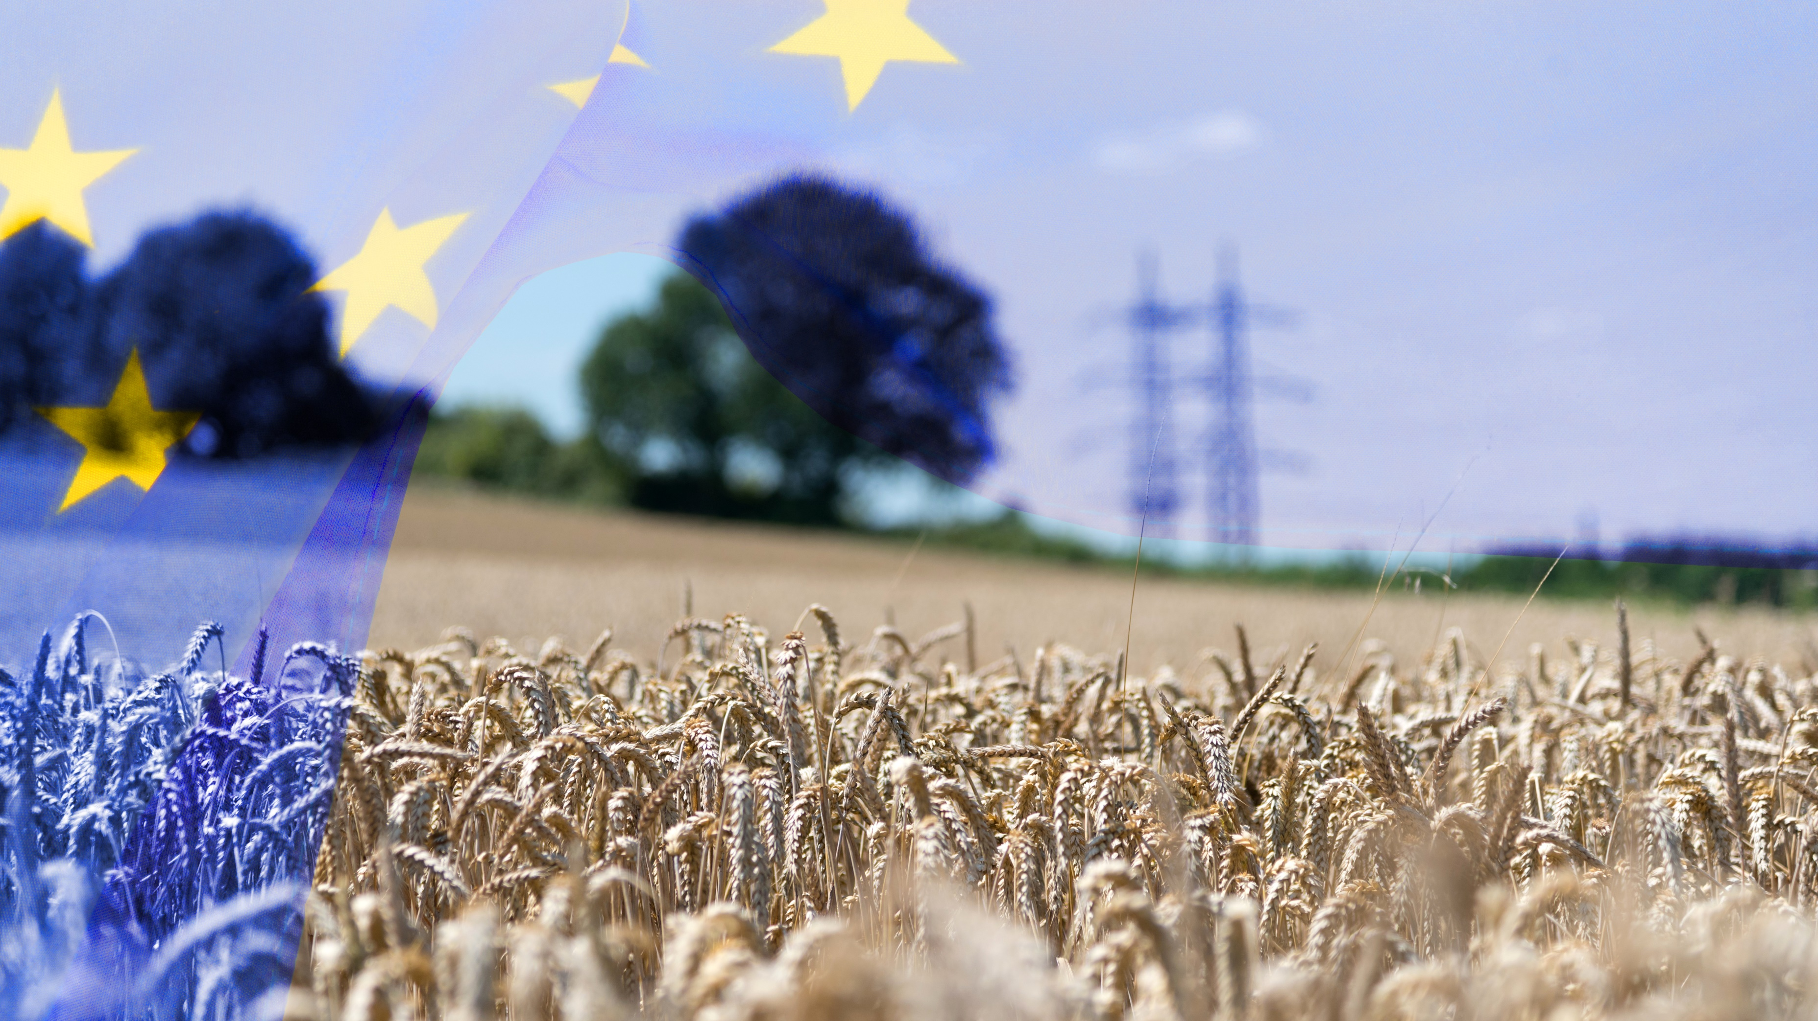
Short term: life-line support to keep food supply going
Short term measures
  Immediate support for food businesses
  (REPowerEU, Temporary Crisis Framework, etc.)
  Temporary flexibility (labelling, official controls, imports)
  Single Market action ( “Green Lanes”)
  Push-back on export bans and restrictions
  Reducing administrative burden for food companies

Slide 8
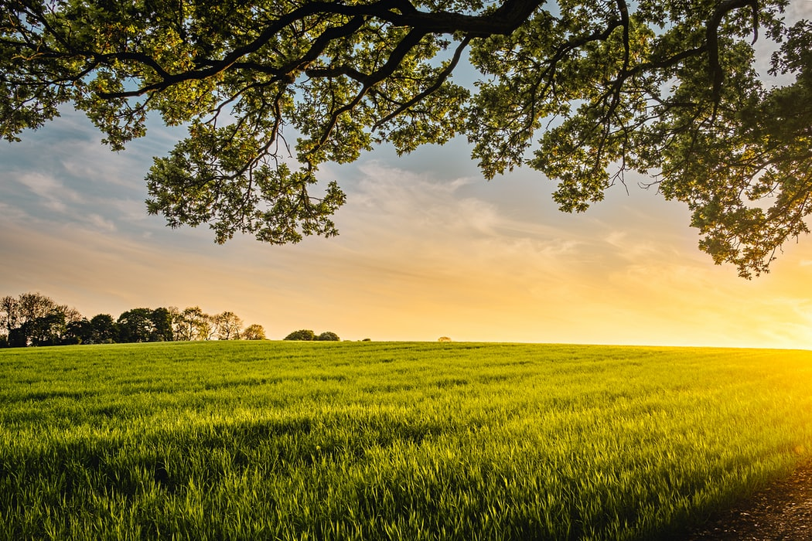
The way out: achieving food systems which are resilient and sustainable
Medium- to long-term
    Food sector to be recognised as ESSENTIAL
    Diversification (risk, crops, trade, business, diets, food systems, …)
    Accelerating the green and digital transition while boosting productivity and food security (European Green Deal) → investment in competitiveness, skills, innovation
(Quantity, Quality, Price)

Slide 9
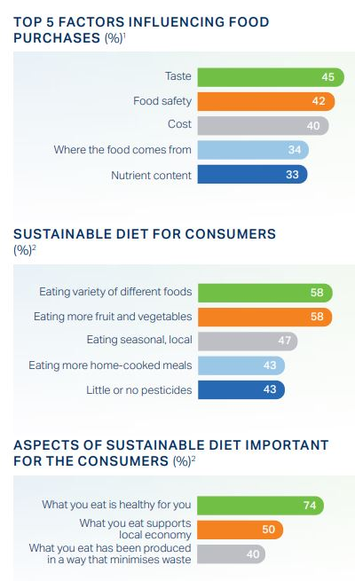
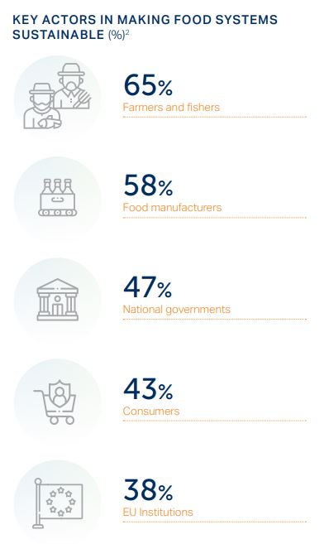
The EU food sustainability agenda: why should companies care?
Consumer trend
Citizens’ expectation
Regulatory direction
Building business resilience
& competitiveness
(Quantity, Quality, Price)
Notes:
Consumer trend: increasing demand for healthy and sustainable options (even though factors such as taste, safety and cost still dominate)
Citizens’ expectation: almost 9 out of 10 Europeans consider that farmers and food companies should themselves take action to raise their products’ sustainability standards
Regulatory direction: with the European Green Deal, in particular the EU Farm to Fork Strategy, the EU has set a clear direction to stimulate a ‘push’ and ‘pull’ for sustainable production and consumption of food.
Business resilience & competitiveness: investment in sustainability, whether it is in improving resource-use at the operational/process level or by strategically tapping into markets such as plant-based, can result in improved economic performance. The best sustainable companies usually improve future profitability, as has been shown by research.

Slide 10
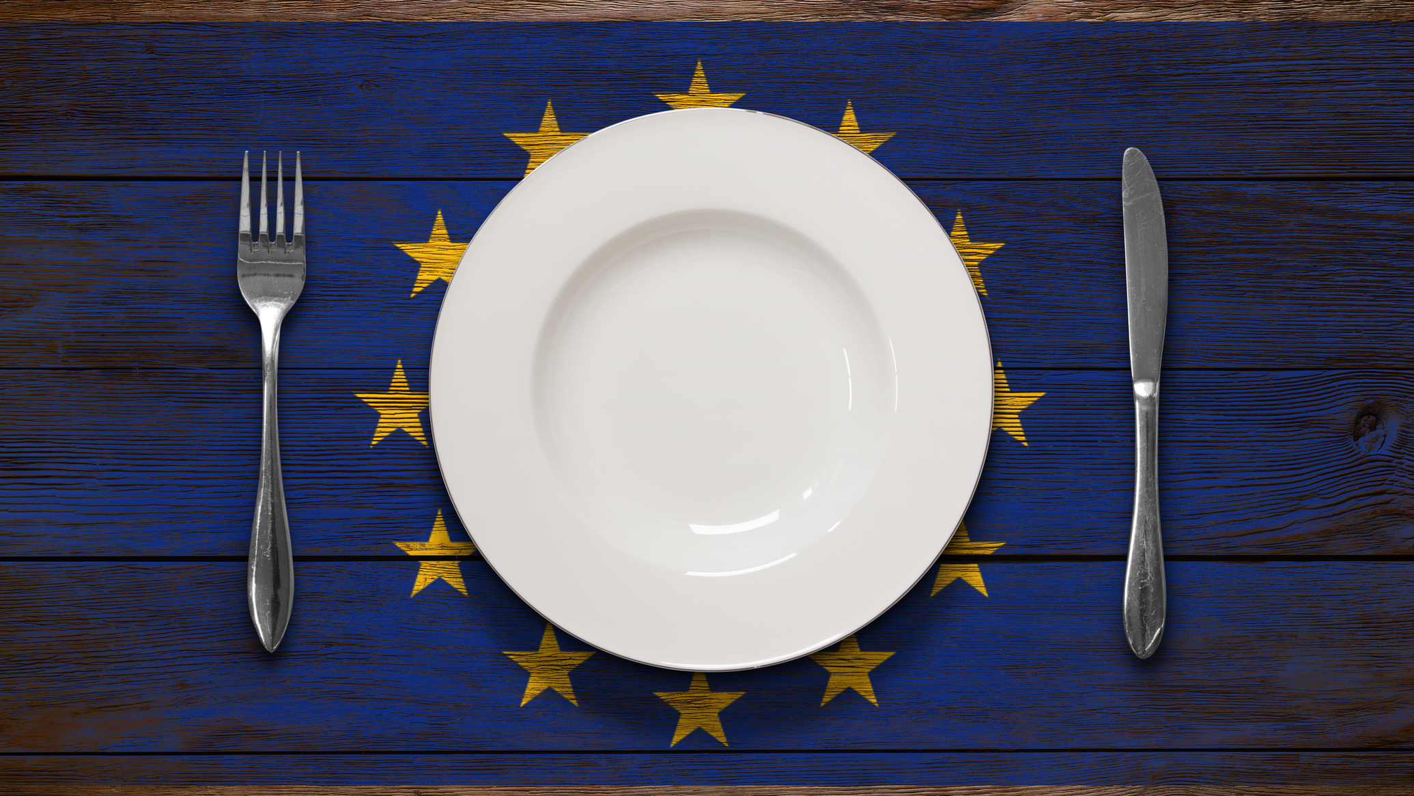
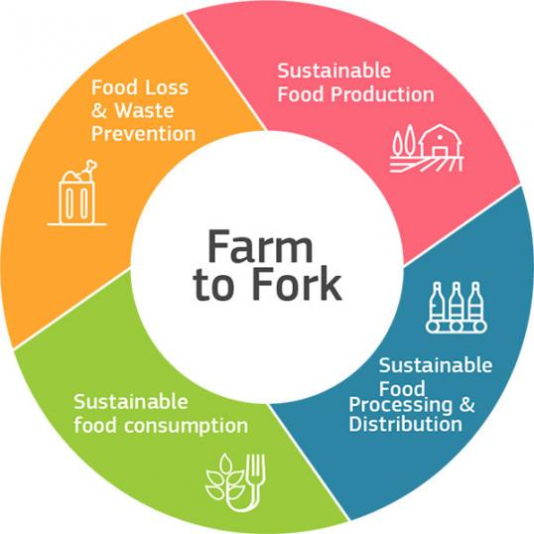
The European Green Deal: pathway to sustainable (food) systems?
Europe’s Beating Cancer Plan (BECA)
Climate Law (“Fit for 55”)
Sustainable Chemicals Strategy
Biodiversity Strategy
EU Taxonomy
Circular Economy
Action Plan
Horizon Europe
Common Agricultural Policy (CAP)

Slide 11
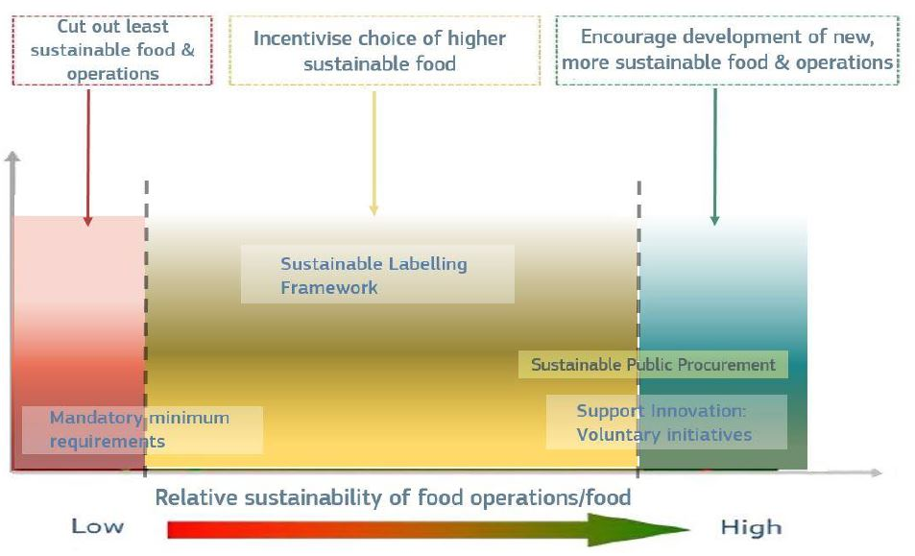
2022 onwards
From Communication(s) to implementation…
Packaging circularity
Food Contact Materials
Consumer information
FOP nutrition labelling & nutrient profiles
Country of origin labelling
Date marking
Alcoholic beverage labelling
Green claims
Environmental & social sustainability
Deforestation
Corporate sustainability due diligence
Carbon removal certification
Packaging & Packaging Waste
Recycled plastic materials
Legislative Framework on Sustainable Food Systems (2023)

Slide 12
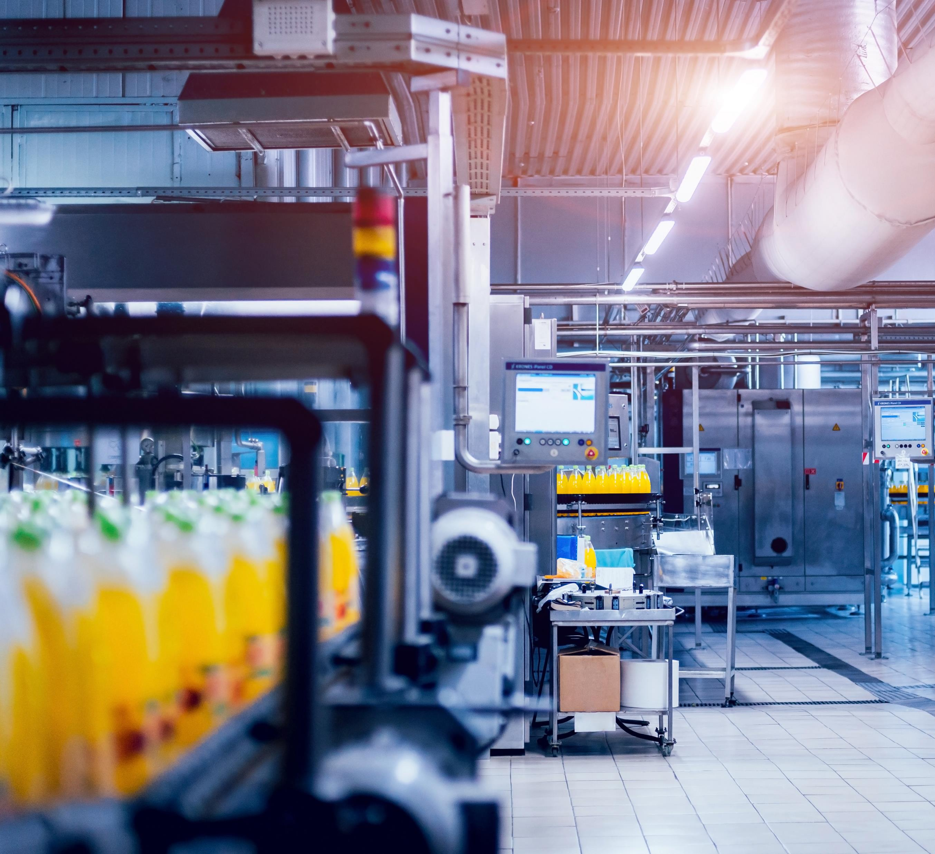
Concluding remarks
Unprecedented times (unprecedented measures?)
Sustainability ≠ environmental only = 3 pillars integrated
Food security, sustainability and profitability can go hand-in-hand
Key recommendation for policy-makers:
Consider food sector as priority sector
(enable the transition)
(Quantity, Quality, Price)

Slide 13

Thank you!

